Slide 1
Branching and Looping in Python
By
Anirudh K M
Analyst, Mobius Knowledge Services

Slide 2
Branching statement
The conditional statement is the most simplest of all branching statements.
When a condition is checked it returns only True or False.
If True, a certain set of statements are executed, if False another set of statements are executed which is optional to include.

Slide 3
Control flow
True False
Code
Test
True
Block
False
Block
Code

Slide 4
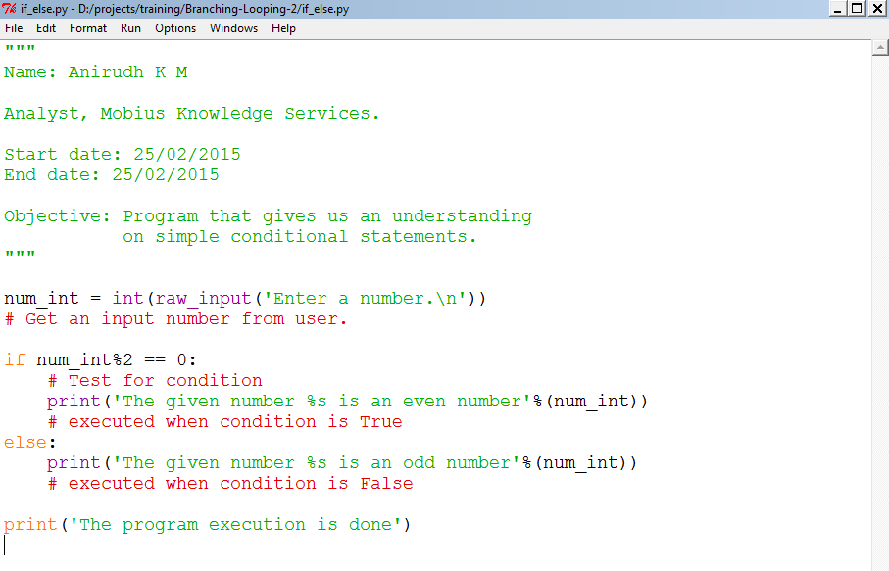
Illustration - Script

Slide 5
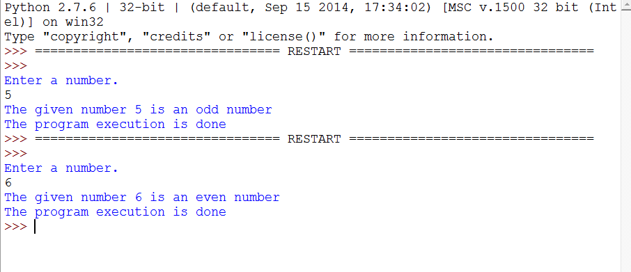
Illustration - Output

Slide 6
Indentation
If we look on the script, we see that the conditional statements are being indented.
Each indented set of statements denotes a particular block of code.
Too illustrate, if the last statement was indented, it would have been executed along with the else statement.
The indentation also provides a good visual representation for the readers.
We use the notation ‘:’ to indicate that an indented block is up ahead.

Slide 7
Nested conditional statement
Like a simple if, else statement.
We could also have statements to check more than one condition.
Also we could have nested conditional statements.
Let us look at few examples that gives us a clear understanding.

Slide 8
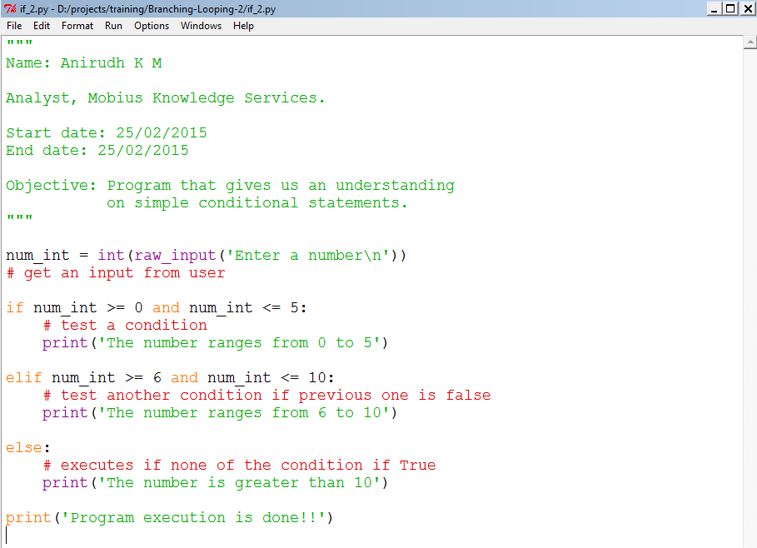
Illustration

Slide 9
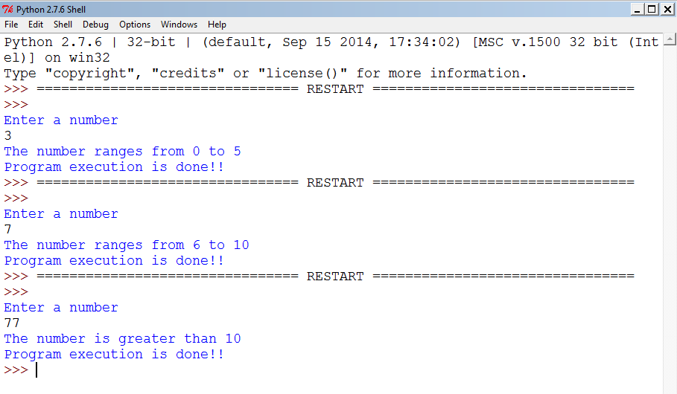
Illustration

Slide 10
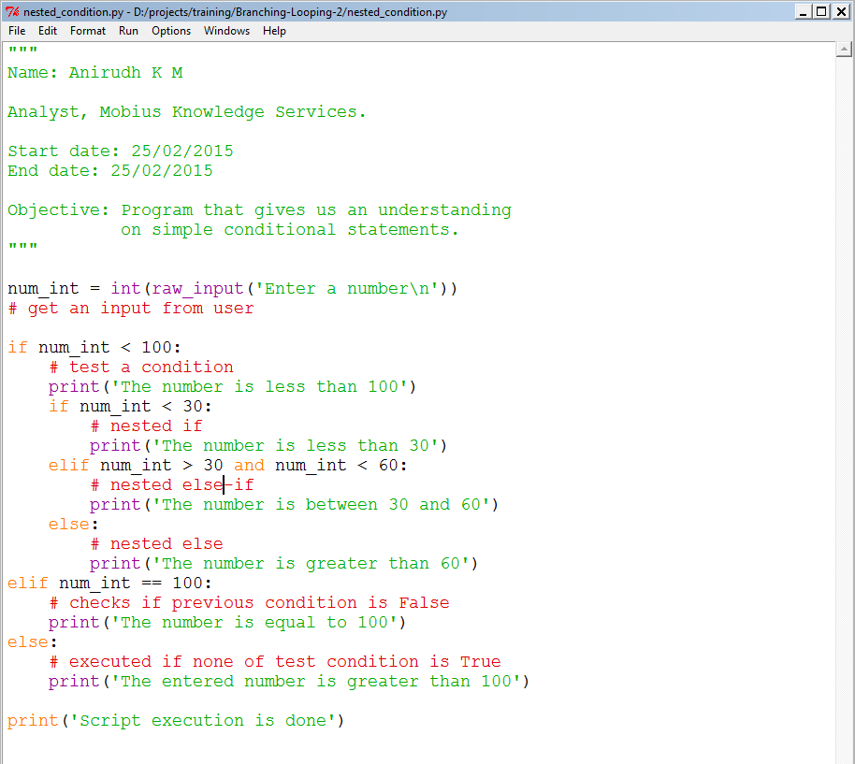
Illustration

Slide 11
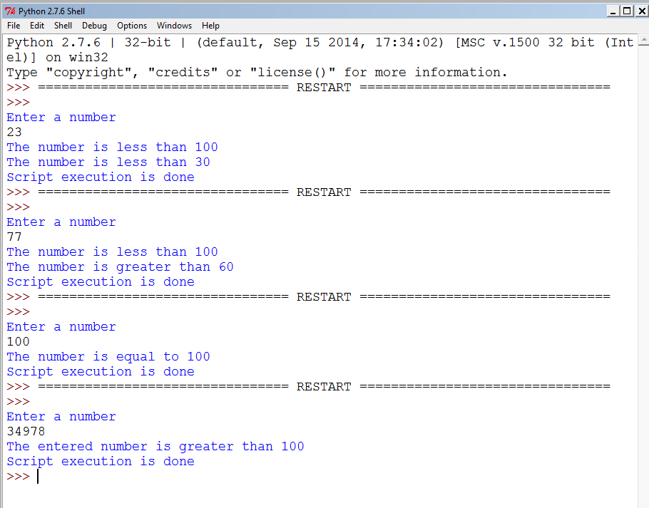
Illustration

Slide 12
Looping statements
Like branching we could also use looping statements, to iterate over a particular set of statements.
The two ways for looping.
while loop.
for loop.
The beauty of Python is that, we can include else statement in while and for loops also.

Slide 13
while loops
First lets take a look at the while loop.
Syntax:
while <condition>:
Set of statements # executed till the condition is True
else: # optional
Set of statements

Slide 14
Properties of while loop
You need to set an iteration variable outside the while loop.
Make a test to check the condition on that variable.
You need to make sure that this iteration variable is incremented or decremented within the loop apart from the other statements in the loop.

Slide 15
Control flow
True False
Code
Test
Loop
Body
Code

Slide 16
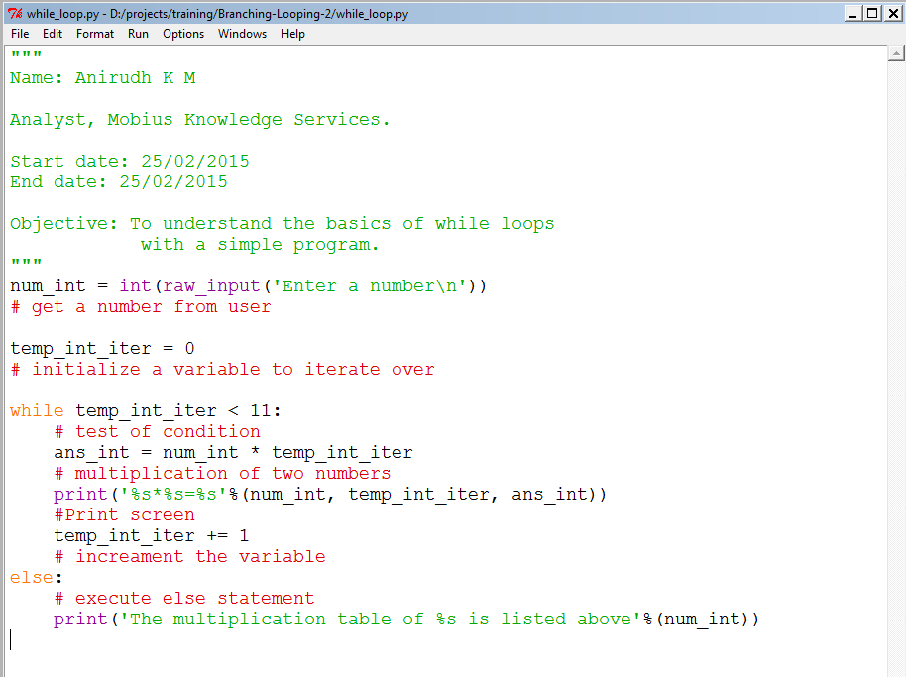
Illustration

Slide 17
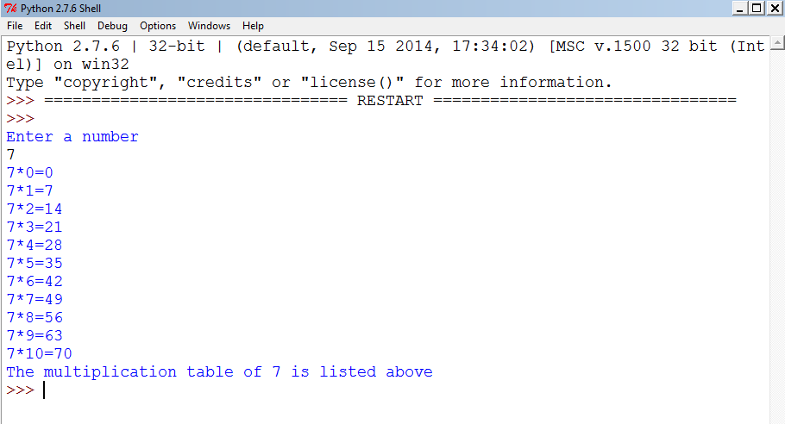
Illustration - output

Slide 18
While loops
The above programs shows a superficial idea on how the while loop works.
We also see that the else statement is also executed.
Let us put a hold to the else statement as of now, we will look on that as we move further.

Slide 19
For loops
For is another awesome looping mechanism.
There is a subtle difference between for and while loop which we will understand when we learn more on Python.
Syntax:
for <identifier> in <sequence>:
Statements to be executed.
else: #optional
Statements to be executed.

Slide 20
How for loop works
First, the identifier value is assigned to first value of sequence.
Next, the set of indented statements are executed under the for loop.
Next identifier value is changed to the second value of sequence.
This is repeated over again and again till the for loop is exhausted or a break statement is executed in the loop.

Slide 21
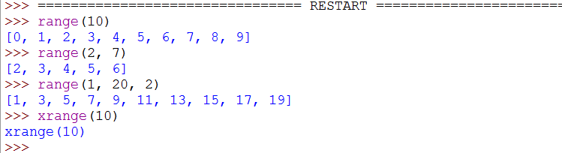
Sequences
Sequences are a set of object, just like an array.
To generate a sequence of integers, use the following:

Slide 22
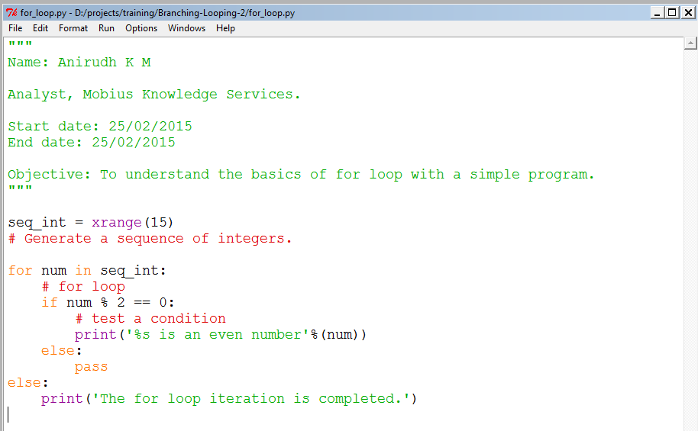
Illustration

Slide 23
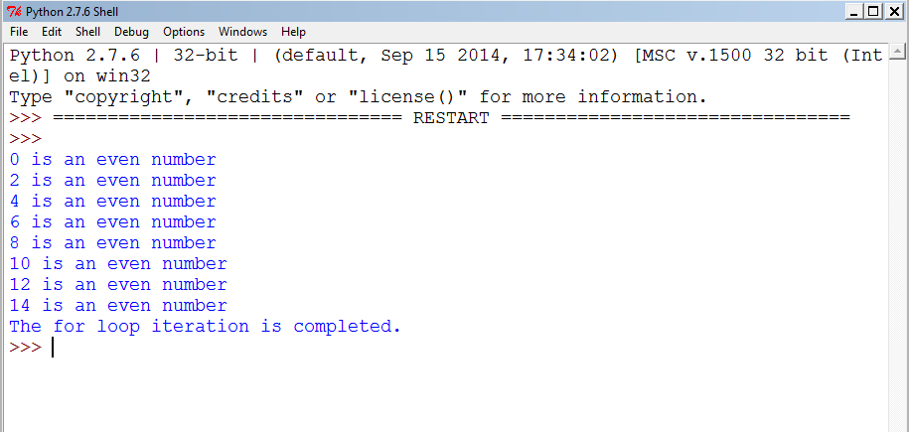
Output

Slide 24
for loop
Now we also have a superficial idea on how the for loop works.
We also observe that the else clause is executed too.
One of the important thing in for loop is that the sequence should always be an iterable object.

Slide 25
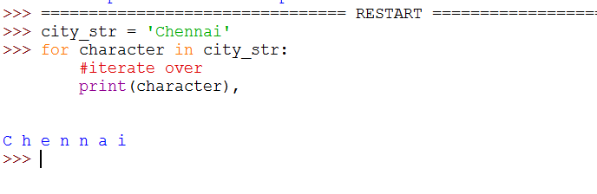
for loop
In this we see that a string is also an iterable object.
Try to repeat the same with integers and check the result.

Slide 26
break and continue statement
We can use the break and continue statements in looping mechanism.
These statements really adds a lot of flexibility to the looping mechanism.
Let us look at few examples to understand these.

Slide 27
Break statement
The break is used to stop the execution of loop.
Generally a condition is checked in the loop, if that condition is satisfied that the break statement is executed to break the loop.
Let’s look at an example.

Slide 28
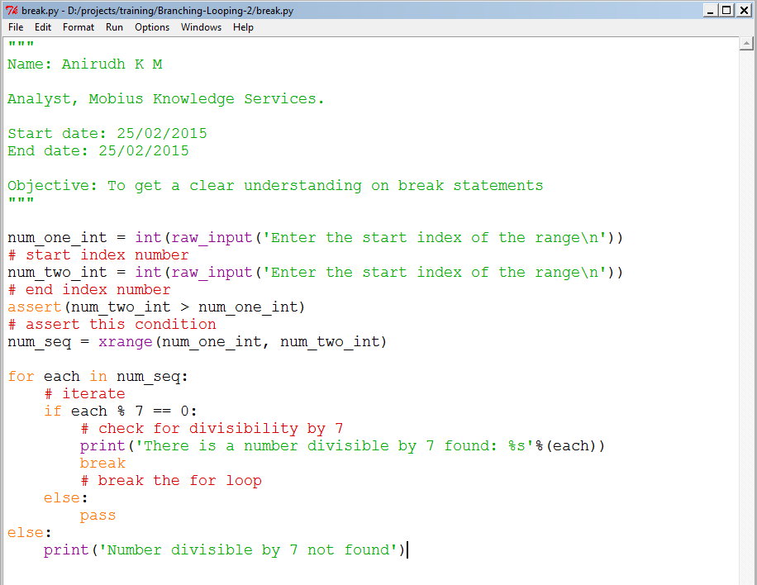
break statement - Illustration

Slide 29
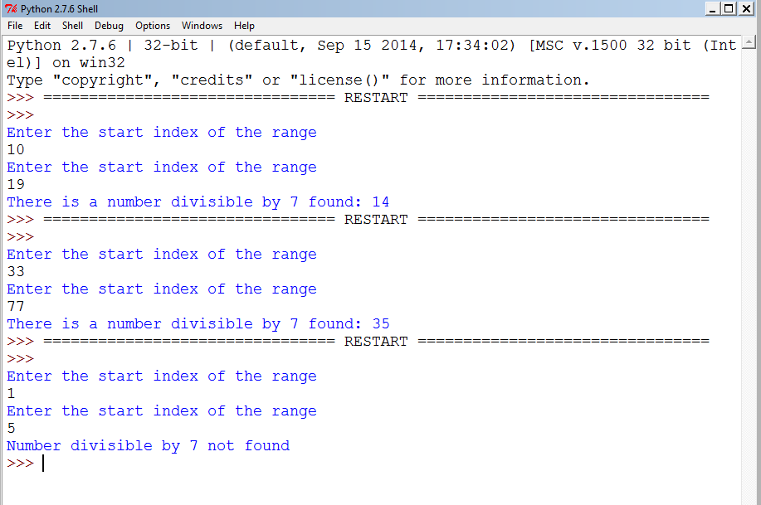
Output

Slide 30
continue statement
The continue statement instead to breaking the loop, will start executing the loop from beginning without executing the statements after that when executed.
Similar to break, continue statement is also executed when a particular condition is executed.
Let us look at an example to understand this.

Slide 31
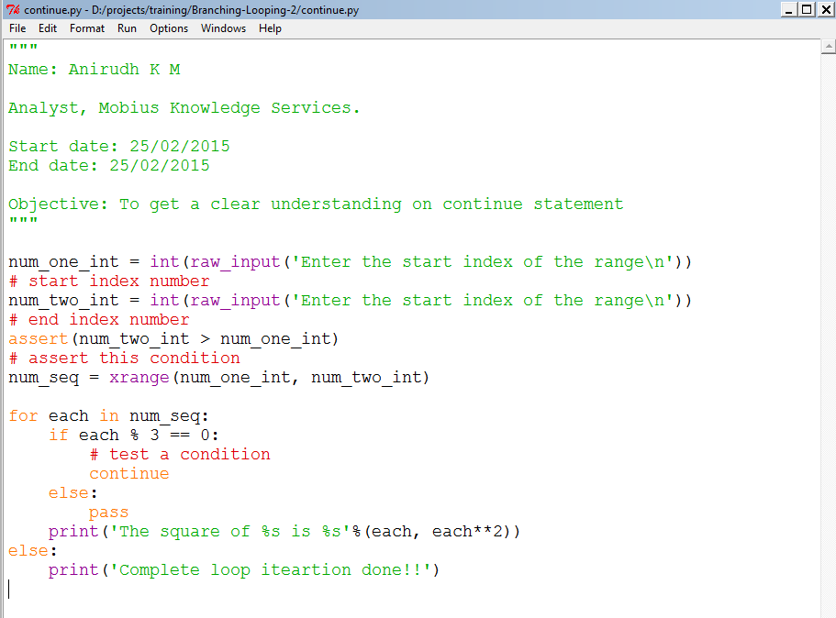
continue - Illustration

Slide 32
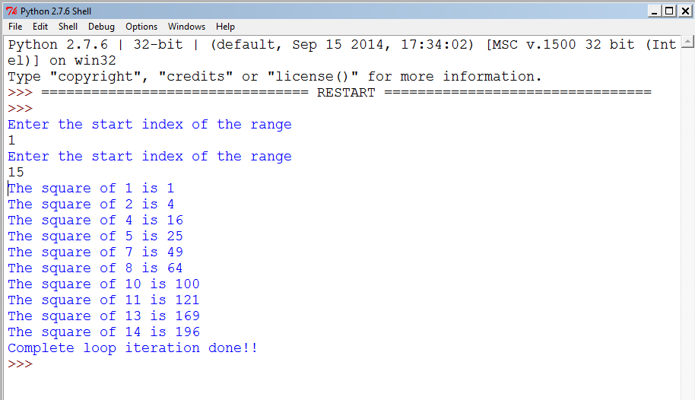
Output

